Slide 1
International Strategic Alliances：
Design and Management
Multinational Management
耿延

Slide 2
Learning Objectives (1 of 3)
Know the steps for implementing successful international strategic alliances.
Describe how multinational companies link value chains in international strategic alliances.
Understand the importance of choosing the right partners for alliances.
Know the important characteristics to look for in potential alliance partners.

Slide 3
Learning Objectives (2 of 3)
Distinguish between equity-based international joint ventures and other types of international cooperative alliances.
Know the basic components of an international strategic alliance contract.
Understand the control systems and management structures used in alliance organizations.

Slide 4
Learning Objectives (3 of 3)
Appreciate the unique problems in human resource management faced by managers in alliance organizations.
Realize the importance of interfirm commitment and trust for building successful international strategic alliances.
Understand how multinational companies assess the performance of their international strategic alliances.
Know when companies should dissolve or continue their international strategic alliances.

Slide 5
Strategic Alliance Issues
Although strategic alliances are a fast and flexible way to break into new markets, they are inherently unstable, for these reasons:
  They may be poorly designed or managed.
  Partnering with a company from a different nation compounds management difficulties.
  Partners may disagree on how to run the business.
  Even profitable alliances can be torn by conflict.

Slide 6
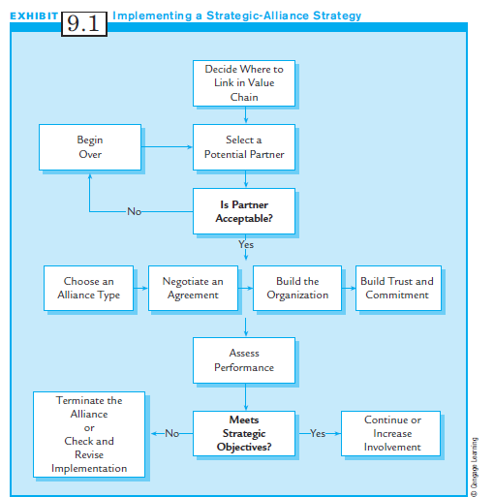
Exhibit 9.1:
Implementing a
Strategic-Alliance Strategy

Slide 7
Where to Link in the Value Chain
Many benefits of strategic alliances:
  Gain access to local partner’s knowledge of market, meet government requirements, share risks, share technology, economies of scale, access lower cost raw materials or labor etc..
Alliances combining same value-chain activities gain efficiencies, merge talents, and share risks.
Where to link depends on the firm’s strategic objective.

Slide 8
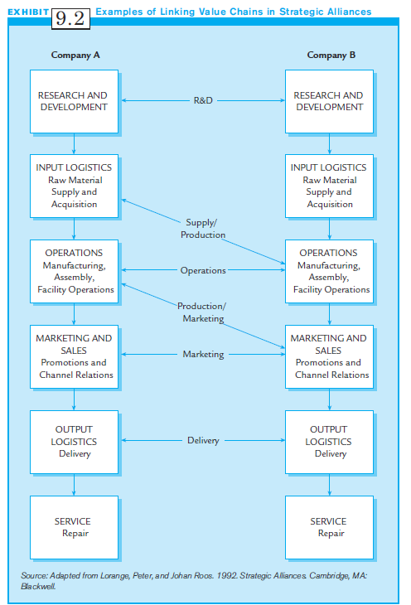
Exhibit 9.2:
Examples of Linking Value Chains in Strategic Alliances

Slide 9
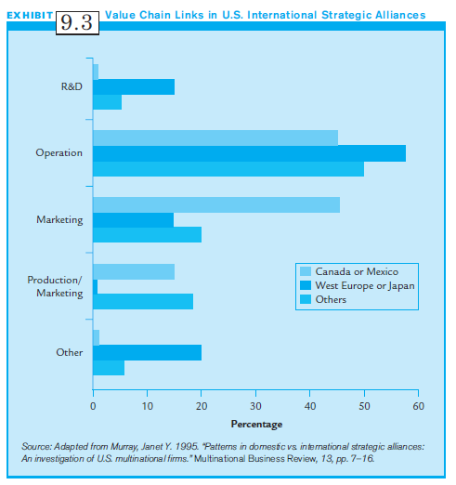
Exhibit 9.3:
Value-Chain Links in US International Alliances

Slide 10
Choosing a Partner:
The Most Important Choice?
The success or failure of a strategic alliance depends on how well the partners get along.
Especially early in the relationship, each party must believe it has a good partner who can deliver on promises and be trusted.
Picking the wrong partner can have negative major consequences.

Slide 11
Key Criteria for
Choosing a Partner (1 of 3)
There are several key criteria for choosing an appropriate alliance partner:
  Seek strategic complementarity.
    Prospective partners must understand each other’s strategic objectives, short & long term.
  Pick a partner with complementary skills.
    Technical complementarity is most important.
    Find partners with similar but not identical products.

Slide 12
Key Criteria for
Choosing a Partner (2 of 3)
Seek out companies with compatible management styles.
Seek a partner that will provide the “right” level of mutual dependency; partners must rely on each other.
Avoid the “anchor” partner:
    Anchor Partner: a partner that holds back the strategic alliance because it cannot or will not provide its share of the funding.

Slide 13
Key Criteria for
Choosing a Partner (3 of 3)
Be cautious of the “elephant-and-ant” complex.
  This occurs when two companies are greatly unequal in size.
  The large firm may dominate the smaller firm.
Assess operating policy differences with potential partners.
Assess the difficulty of cross-cultural communication with a likely partner.

Slide 14
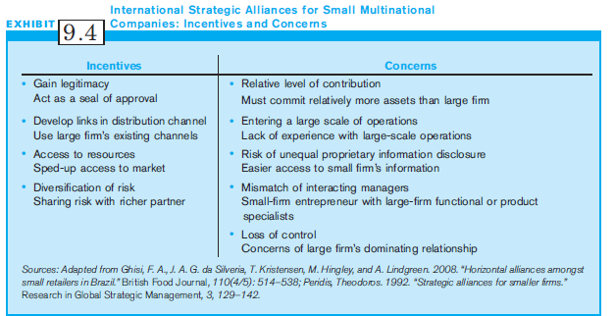
Exhibit 9.4:
International Strategic Alliances for Small Multinational Companies

Slide 15
Choosing an Alliance Type
There are three main types of strategic alliances:
  Informal international cooperative alliances
  Formal international cooperative alliances (ICAs)
  International joint ventures (IJVs)

Slide 16
Informal International Cooperative Alliance
An Informal International Cooperative Alliance is:
  A non-legally binding agreement between companies from two or more countries to cooperate.
  They may be agreements of any kind, and may provide links anywhere on their value chains.
  Because there is no legally-binding agreement, managers usually limit the scope of involvement, and resist revealing proprietary information.

Slide 17
Formal International Cooperative Alliances (ICAs)
A formal International Cooperative Alliance (ICA)
  Calls for high degree of involvement with partners.
  Usually, a formal contract specifies what each partner will give and receive.
  May require sharing proprietary information, which makes backing out of this alliance more difficult.
  Sometimes one partner may take an equity share of ownership of the other.

Slide 18
International Joint Ventures (IJVs)
An International Joint Venture is a self-standing legal entity owned by two or more parent companies from different countries; each has an equity interest.
The venture need not be equally owned.
Contributions may be cash, technology or other resources.
If there are many members, the entity is called a consortium.

Slide 19
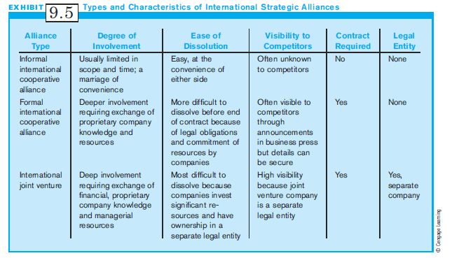
Exhibit 9.5:
Types of Alliances

Slide 20
Negotiating the Agreement
Both formal ICAs and IJV require a negotiated and signed contract.
Negotiation issues include:
  Products or services of the alliance
  Equity contributions (cash or other resources)
  Management structure
  “Prenuptial” agreements regarding dissolution

Slide 21
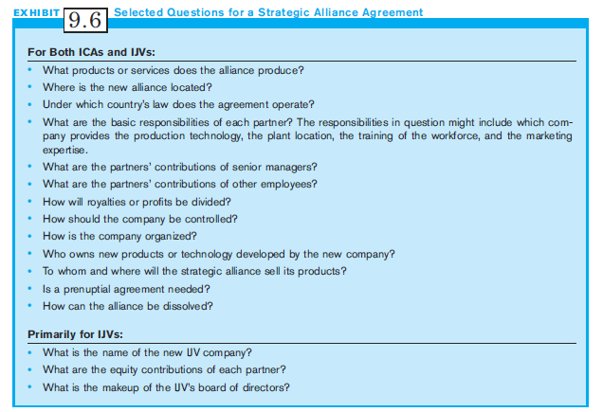
Exhibit 9.6:
Selected Questions for a Strategic-Alliance Agreement

Slide 22
Organizational Design in Strategic Alliances
Design of the organization depends on the type of alliance chosen.
Informal ICAs often do not require formal design.
Formal ICAs may require a separate organizational unit housed in one company, with employees from both.
IJVs are separate legal entities, and require a separate organization to carry out the alliance’s objectives.

Slide 23
Decision-Making Control
There are two major areas of decision making:
  Operational decisions (daily running of organization)
  Strategic decisions (strategy for long term survival)
Majority owners do not necessarily control both areas.
IJVs’ strategic decision-making takes place at the level of the IJV’s board of directors or top management.
In non equity ICAs, strategic decisions remain with parent companies.

Slide 24
Management Structures (1 of 3)
MNCs typically use five management control structures for their ICAs or IJVs:
  1. Dominant Parent: The Dominant Parent controls strategic and operational decision making.
    Often has majority ownership
    Treats the IJV as its wholly owned subsidiary
  2. Shared Management: both parent companies contribute approximately the same number of managers to the alliance organization

Slide 25
Management Structures (2 of 3)
MNCs typically use five management control structures for their ICAs or IJVs: (cont’d)
  3. Split Control Management: Partners usually share strategic decision making and make functional decisions independently.
  4. Independent Management: Alliance managers act more like managers from a separate company.
    IJVs often recruit managers from outside the parent companies.

Slide 26
Management Structures (3 of 3)
MNCs typically use five management control structures for their ICAs or IJVs: (cont’d)
  5. Rotating Management: Managers from the partners rotate through the key positions in the management hierarchy.
    This structure is popular in developing countries.
    It serves to trains management talent and helps to transfer expertise to the developing country.

Slide 27
Choosing a Strategic Alliance Management Structure (1 of 2)
If partners have similar technologies and know-how, and contribute equally, a Shared Management structure is preferred.
If partners have different technologies but contribute equally, a Split Management structure is preferred.
If one partner has a dominant equity position, or is more important to one partner, a Dominant Management structure is more likely.

Slide 28
Choosing a Strategic Alliance Management Structure (2 of 2)
For joint ventures in particular:
  Mature joint ventures move to independent structures as the joint venture’s management team gains more expertise.
  Joint ventures in countries with a high degree of government intervention produce IJVs with local partner dominance.
  Independent management structures are more likely when the market is expanding, the venture does not require much capital, or the venture does not require much R&D input from its parents.

Slide 29
Commitment and Trust:
The Soft Side of
Alliance Management
Managers from both failed and successful strategic alliances advise the importance of building mutual trust and commitment among partners from the beginning.
Commitment: taking care of each other and putting forth extra effort to make the venture work
  Attitudinal commitment: Willingness to dedicate resources and efforts and face risks to make the alliance work.

Slide 30
Commitment and Trust:
The Soft Side of
Alliance Management
If alliance partners demonstrate these aspects of commitment, the venture will develop based on the principles of Fair Exchange.
  Fair Exchange: Fair exchange occurs when partners believe that they receive benefits from the relationship equal to their contributions.

Slide 31
Calculative Commitment
Commitment also has a practical side:
Calculative Commitment: comes from the evaluations, expectations, and concerns about the future potential for gaining rewards from the relationship.
Businesses require tangible outcomes for a relationship to continue.
A study of commitment in IJVs suggests that commitment increases when both partners achieve their strategic goals.

Slide 32
Trust
Trust and Commitment go hand in hand.
Credibility Trust: the confidence that the partner has the intent and ability to meet promised obligations and commitments.
Benevolent Trust: the confidence that the partner will behave with goodwill and with fair exchange.
The development of trust between alliance partners may take time.

Slide 33
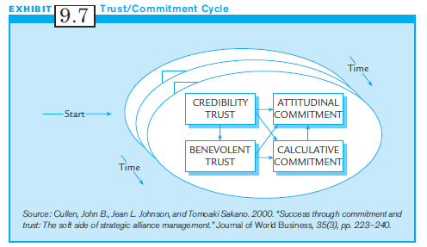
Exhibit 9.7:
The Trust/Commitment Cycle

Slide 34
Why Is Trust Important?
Successful cooperation requires alliance partners to contribute quality inputs to the organization.
When there is no trust, partners hold back or take unfair advantage of each other, making failure likely.
Formal contracts can never identify all issues that will arise, so a trusting relationship is necessary.
Technology and knowledge also include tacit elements that can only be shared when there is trust.

Slide 35
Building and Sustaining
Trust and Commitment
To build and sustain trust and commitment, Multinational managers should consider key factors:
  Pick your partner carefully.
  Know each side’s strategic goals.
  Seek win-win situations.
  Go slowly.
  Invest in cross-cultural training.
  Invest in direct communication.
  Find the right levels of trust and commitment.

Slide 36
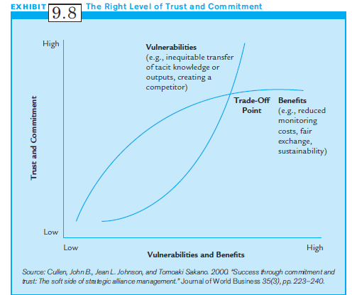
Exhibit 9.8:
The “Right” Levels of
Trust and Commitment

Slide 37
Assessing the Performance of an International Strategic Alliance
If the strategic intent is to produce immediate results, use standard financial and efficiency measures.
Some strategic alliances provide indirect strategic benefits, but may never generate profits.
To assess IJV and ICA performance, criteria other than financials must be included, such as organizational learning, and subjective measures like alliance satisfaction and harmony.

Slide 38
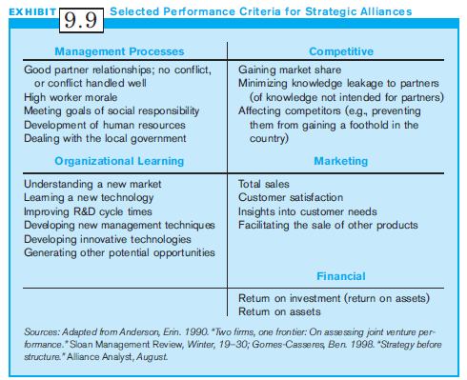
Exhibit 9.9:
Selected Performance Criteria for Strategic Alliances

Slide 39
If the Alliance Does Not Work (1 of 2)
If an alliance does not work, there are two choices:
  Improve implementation, or
  Negotiate an end
Know when to quit and when to invest more.
Avoid “escalation of commitment:”
  Managers continue in an alliance longer than necessary because of past financial and emotional investments.

Slide 40
If the Alliance Does Not Work (2 of 2)
Plan the end at the beginning.
  Create “prenuptial agreements” at the start of the venture in which the partners decide how to terminate the alliance.
  The advantage of the “prenuptial” is that negotiation takes place at a positive and friendly stage.
Recognize that death of the venture does not always mean failure.
Many alliances are short term.

Slide 41
Dedicated
Strategic Alliance Units
Alliances are so common that firms are developing Strategic Alliance Units to manage their design. They provide processes and procedures that help managers:
  Identify the need for an alliance
  Evaluate partners
  Negotiate agreements
  Structure the alliance organizations
  Develop specific performance indicators

Slide 42
Key Lessons from
Cross-Border Alliances
Understand and appreciate business and cultural differences.
Keep strong executive support
Communicate.
Practice commitment, trust and dedication.
Have “checkpoints” as the alliance is being implemented.
Review the alliance’s viability.

Slide 43
Summary
The use of international strategic alliances continues to grow in international business.
A solid understanding of the basics and how to manage strategic alliances were provided.
Strategic alliances are prone to failure and great effort must be taken to make them successful.

